Slide 1
Get Moving!
Python with Robots Mission 3
Lesson 3 Objectives 7-8

Slide 2

Pre-Mission Warm-Up
In your Mission 3 Lesson 3 log, answer the pre-mission warm-up questions:
What are some common programming errors you have made during this mission?
How can you avoid the errors, or identify them when they are made?

Slide 3
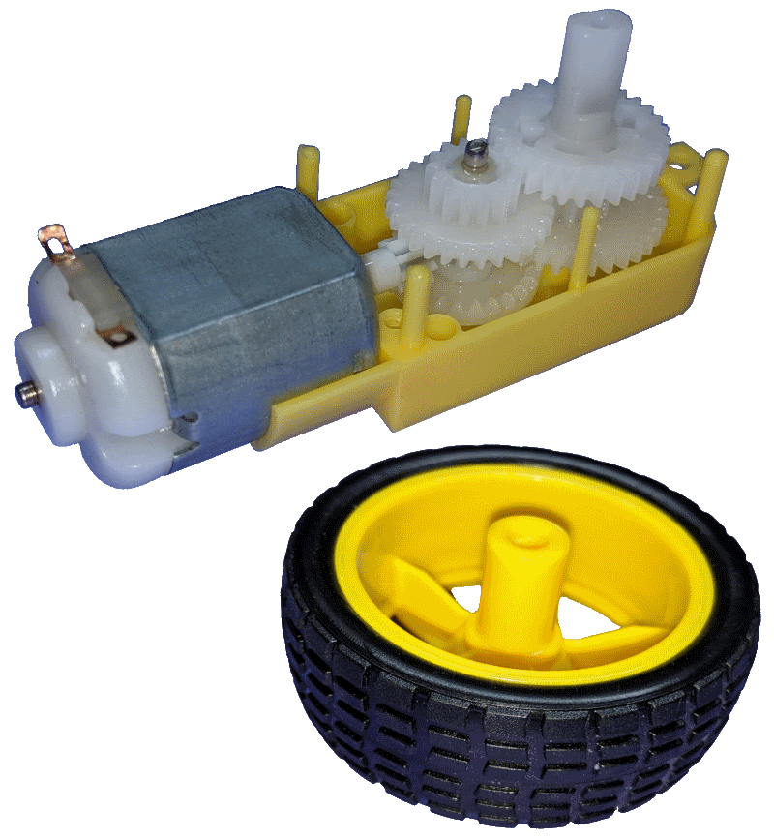
Mission 3: Get Moving!
It’s time to power-up CodeBot’s motors!
Load batteries into your ‘bot.
Set the Power Switch to BATT.
You’ll need some space. Ask your teacher where you will be letting your ‘bot move around.

Slide 4
Objective #7: Get Moving!
Some new code!
from botcore import *
This import statement gives your code access to everything in botcore, not just leds.
The * is a wildcard, and is shorthand for “everything.”

Slide 5
Objective #7: Get Moving!
Some new code!
motors.enable(True)
This code must be called before the motors will move.
motors.enable(False)
This code turns off the motors.

Slide 6
Objective #7: Get Moving!
Some new code!
motors.run(LEFT, 50)
Powers the LEFT motor forward @ 50%
motors.run(LEFT, -50)
Powers the LEFT motor backward @ 50%

Slide 7
Objective #7 Activity
DO THIS:
Start a new file called MoveOut.
Use CodeTrek to power the LEFT wheel.
Answer the first three questions in your mission log.
Run your code.
Note: You can set your ‘bot on your desk or on the floor. It doesn’t have to be disconnected from the computer.

Slide 8
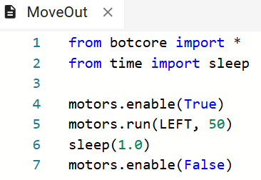
Objective #7 Activity
CODETREK:

Slide 9
Objective #7 Robot Lab
Right now your ‘bot just spins. To move the ‘bot forward, set both motors to the same speed:
motors.run(LEFT, 50)
motors.run(RIGHT, 50)
Powers both motors forward @ 50%
Answer the last question on your mission log.

Slide 10
Objective #7 Robot Lab
DO THIS:
Modify the file MoveOut to power both wheels the same power.
Fill out the Obj. 7 Robot Lab using different powers for the wheels and the sleep delay.
Measure the distance the ‘bot moves for each power / delay combination.
See the next slide for lab hints.

Slide 11
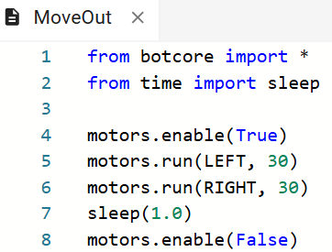
Objective #7 Robot Lab
MODIFIED CODE:

Slide 12
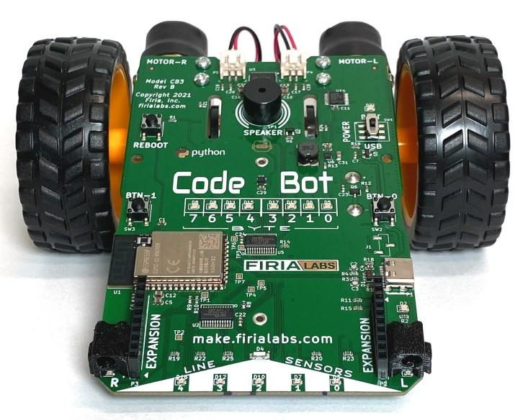
Objective #7 Robot Lab
HINTS:
Use a piece of tape as a starting line so your ‘bot starts in the same place each run.
Hold CodeBot in your hand when you run the code.
When the wheels stop turning, unplug the ‘bot.
Set the ‘bot on the floor at the starting line.
Press the “REBOOT” button. CodeBot will run the code again, and you can measure the distance.
Reconnect the ‘bot every time you make a change to the code, and run the code again.
TAPE MEASURE OR METER STICK

Slide 13

Objective #8: Rotation Time!
You can spin one wheel and move the ‘bot forward. How about rotating?
Spin the wheels in equal but opposite directions to rotate your ‘bot.
One wheel power will be positive, and the other will be negative.
Example:

Slide 14
Objective #8 Robot Lab
Which way does it rotate – clockwise or counterclockwise?
You are going to find out!
What happens when LEFT is positive and RIGHT is negative?
What happens when LEFT is negative and RIGHT is positive?
What does the amount of delay do?

Slide 15
Objective #8 Robot Lab
DO THIS:
Modify the file MoveOut by rotating the wheels.
Fill out the Obj. 8 Robot Lab using different powers for the wheels and the sleep delay.
One wheel is positive and the other negative.
Measure the angle the ‘bot turns for each power / delay combination.
See the next slide for lab hints.

Slide 16
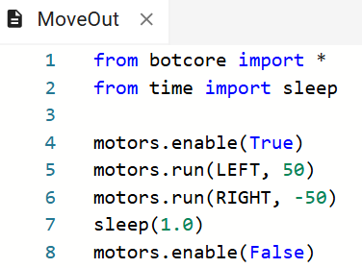
Objective #8 Robot Lab
MODIFIED CODE:

Slide 17
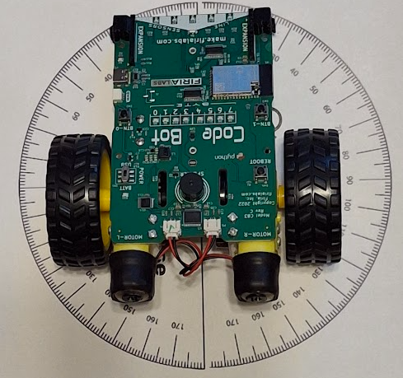
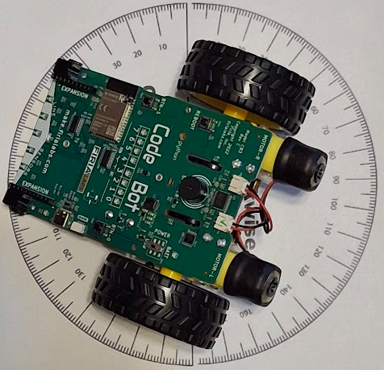
Objective #8 Robot Lab
START:
HINTS:
Measure the angle from line sensor LED 2.
Set up protractors to measure the direction of rotation.
Hold CodeBot in your hand when you run the code.
When the wheels stop turning, unplug the ‘bot.
Set the ‘bot on the floor inside the protractors.
Press the “REBOOT” button. CodeBot will run the code again, and you can measure the angle with the protractor.
Reconnect the ‘bot every time you make a change to the code, and run the code again.
AFTER

Slide 18
Post-Mission Reflection
Complete the post-mission reflection in your Mission 3 Lesson 3 Log

